Slide 1
About ME
10512 김택서
Web design parity

Slide 2

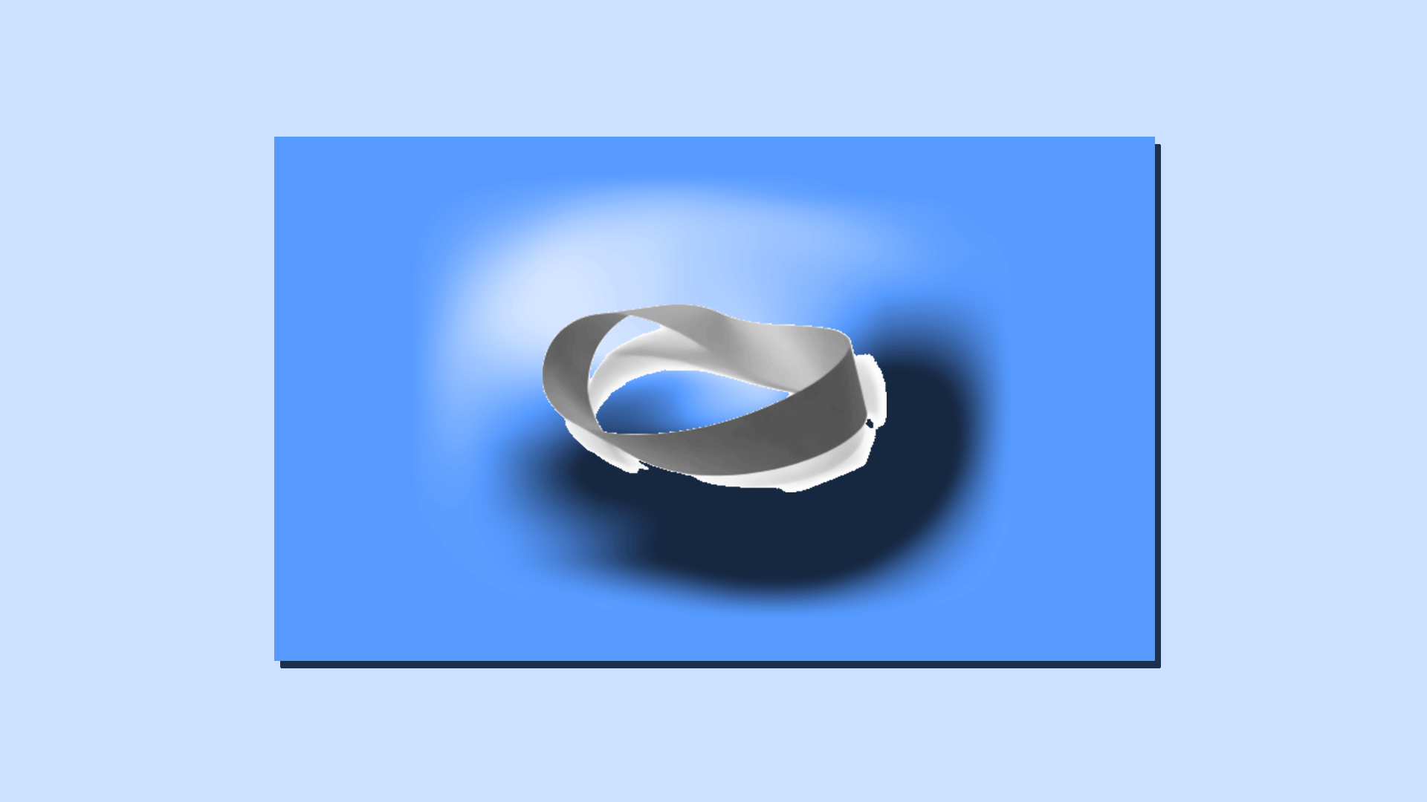
Main symbol Growth process Dream Future figure

Slide 3
Main symbol Growth process Dream Future figure

Slide 4

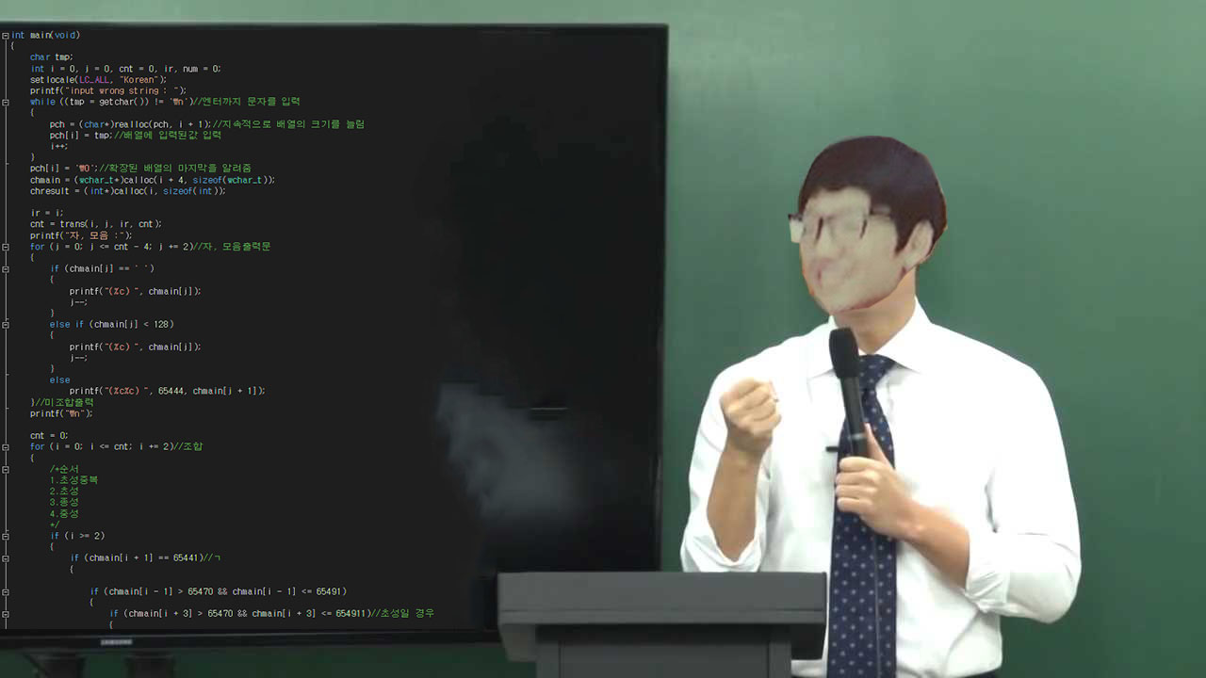
Main symbol Growth process Dream Future figure

Slide 5
Main symbol Growth process Dream Future figure

Slide 6
Fin.

